Slide 1

My First WebPage
Jeff Barton

Slide 2
Goals, gotta have’em
An anime / manga fansite where people can input what they read/watched, share those details chat and suggest fav’s probably not seen by others.
- Specify content that will be entered into the fillable form portion of the site.
-Specify what content can be shared.
-Specify types of interaction between users.
-Specify means of interaction between users (Discord chat).
-Specify rules for interaction and implementing ban if necessary.
-Define method for implementation

Slide 3
Why an anime fansite
Lots to choose from (almost too much)
A convenient way to view / suggest / share
Making likeminded friends / fellow otaku’s

Slide 4
MVP
Proof of concept
-Able to type into a form saving to a connected database Title, Author, Mangaka, Description, Date published, Date read, Category(with dropdown selection for category)
-Working About Us, Contact Us Page
-Azure deployment

Slide 5
Full
Working Profiles / user
-Able to create a profile for content saved
-Link to discord chat for overall communication (to include comments/suggestions/salt)
-Otakubox weblink https://theotakubox.subbly.co?r=135380&s=5193

Slide 6
Stretch
Aesthetics
-Able to link images for described anime/manga cover art
-Able to save profiles to PC
-Dynamic CSS overhaul

Slide 7
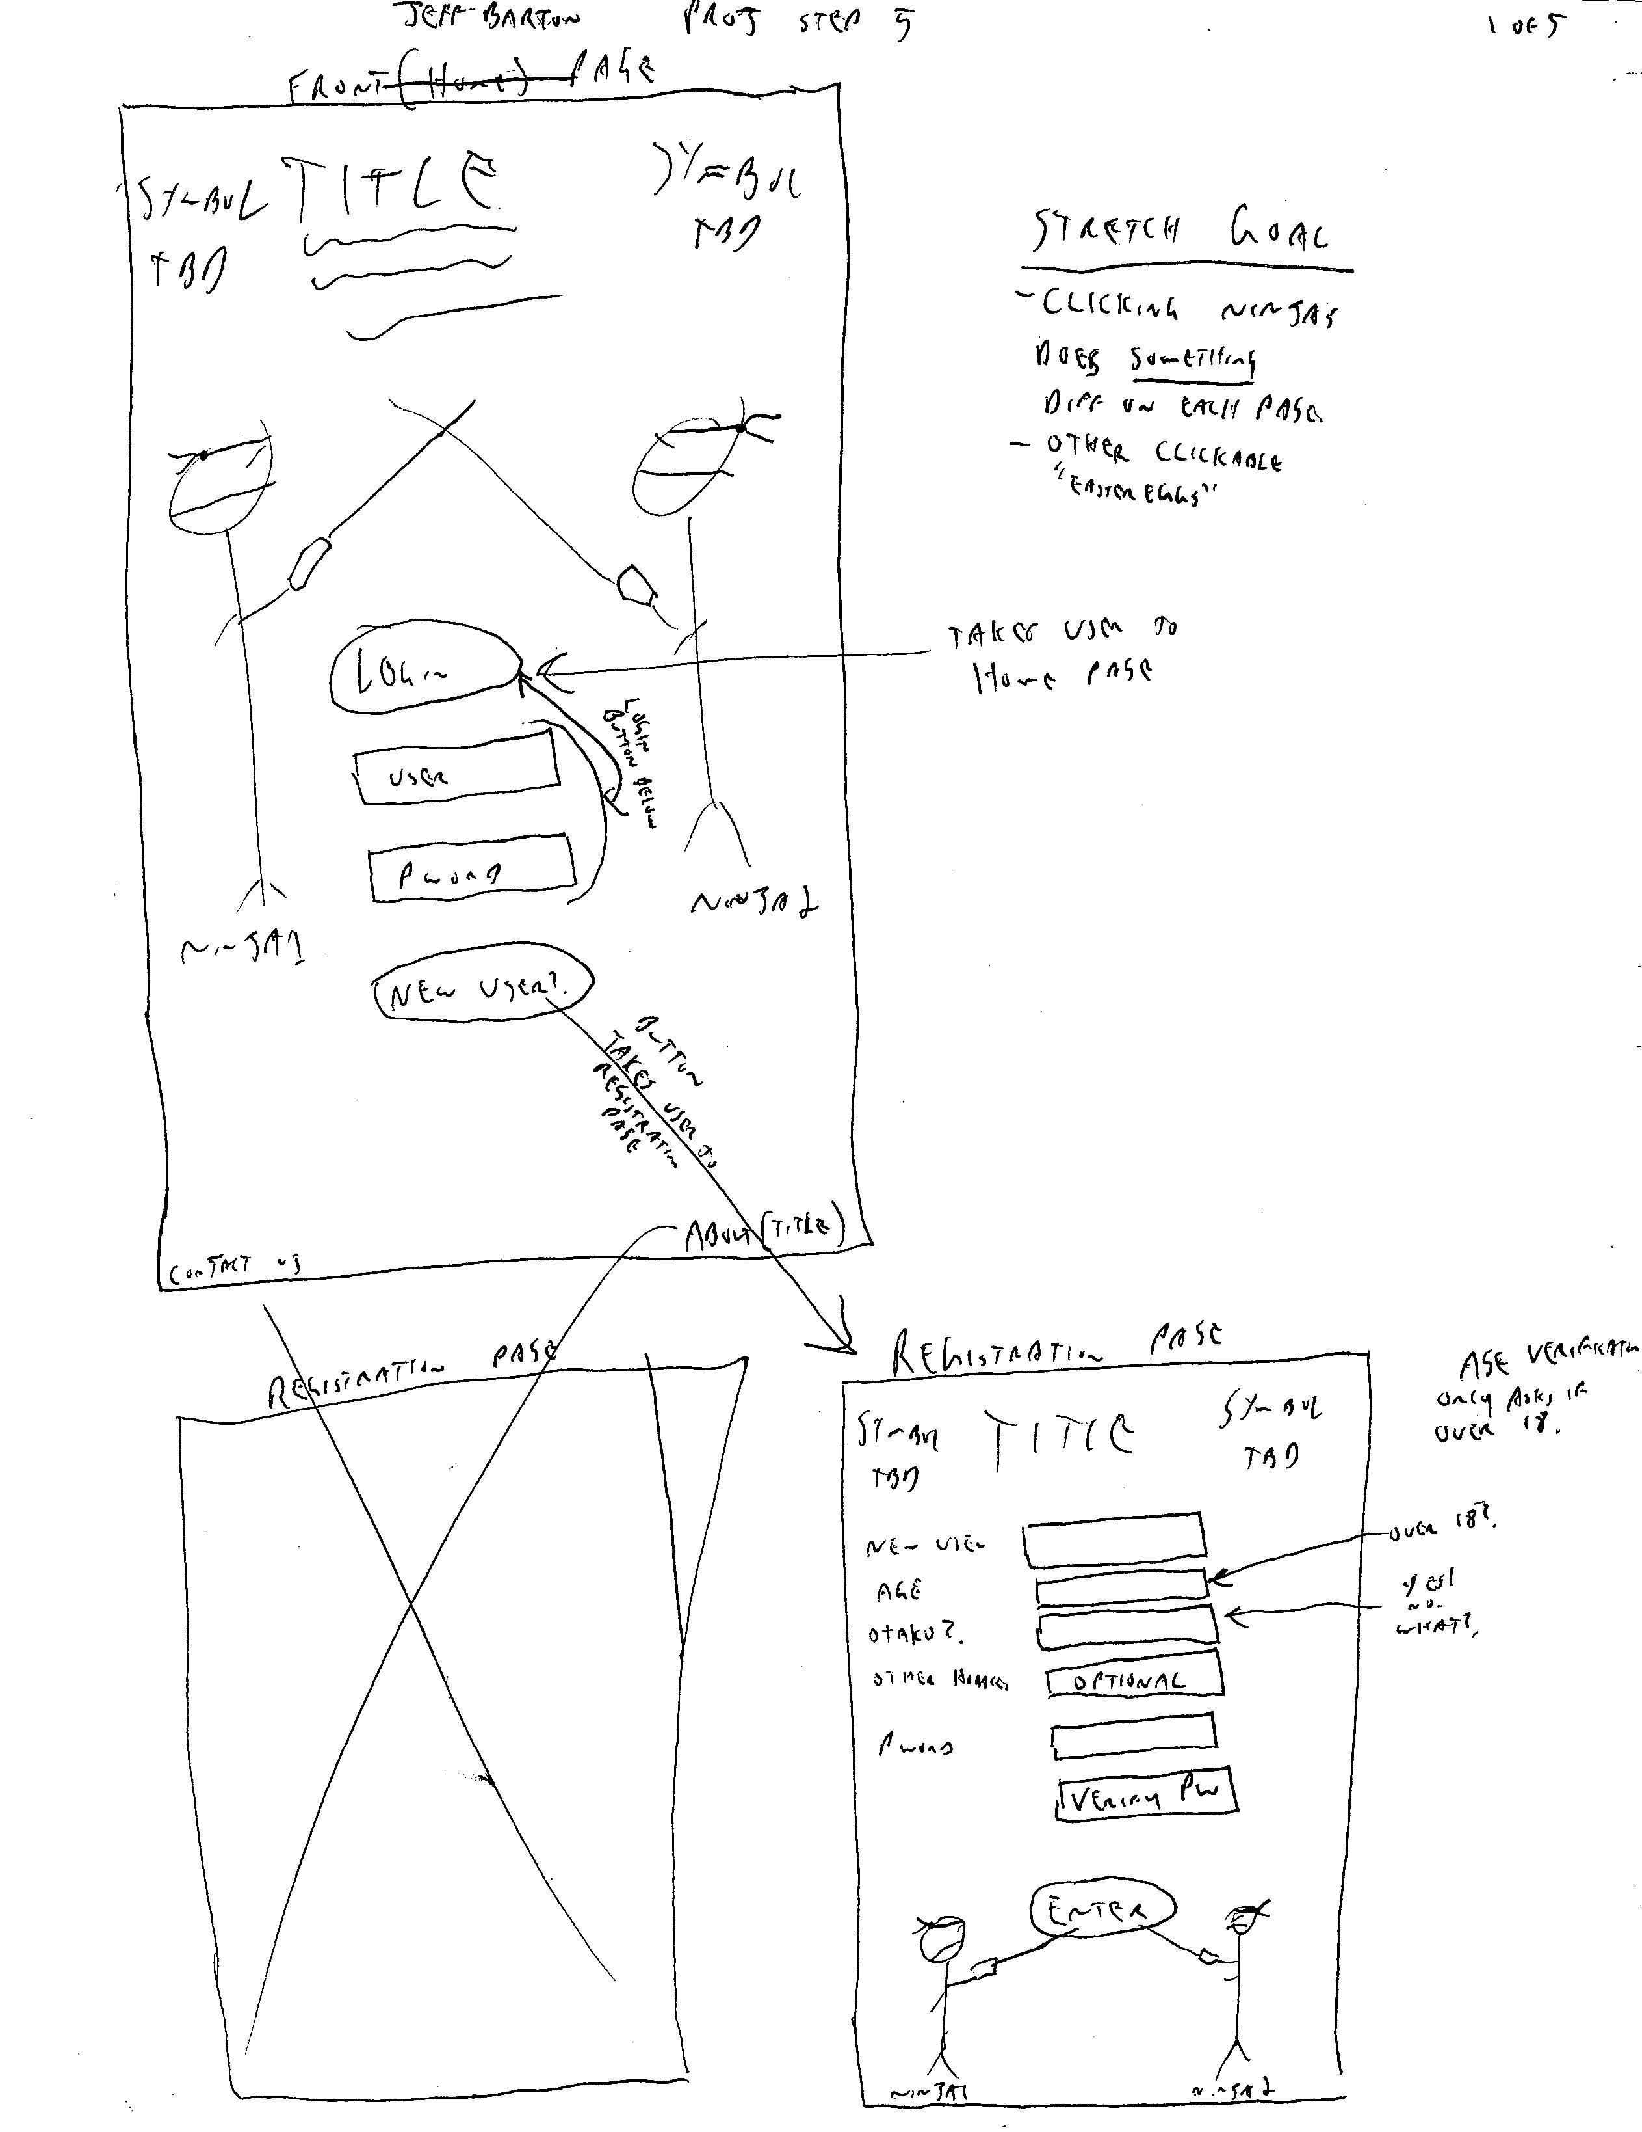
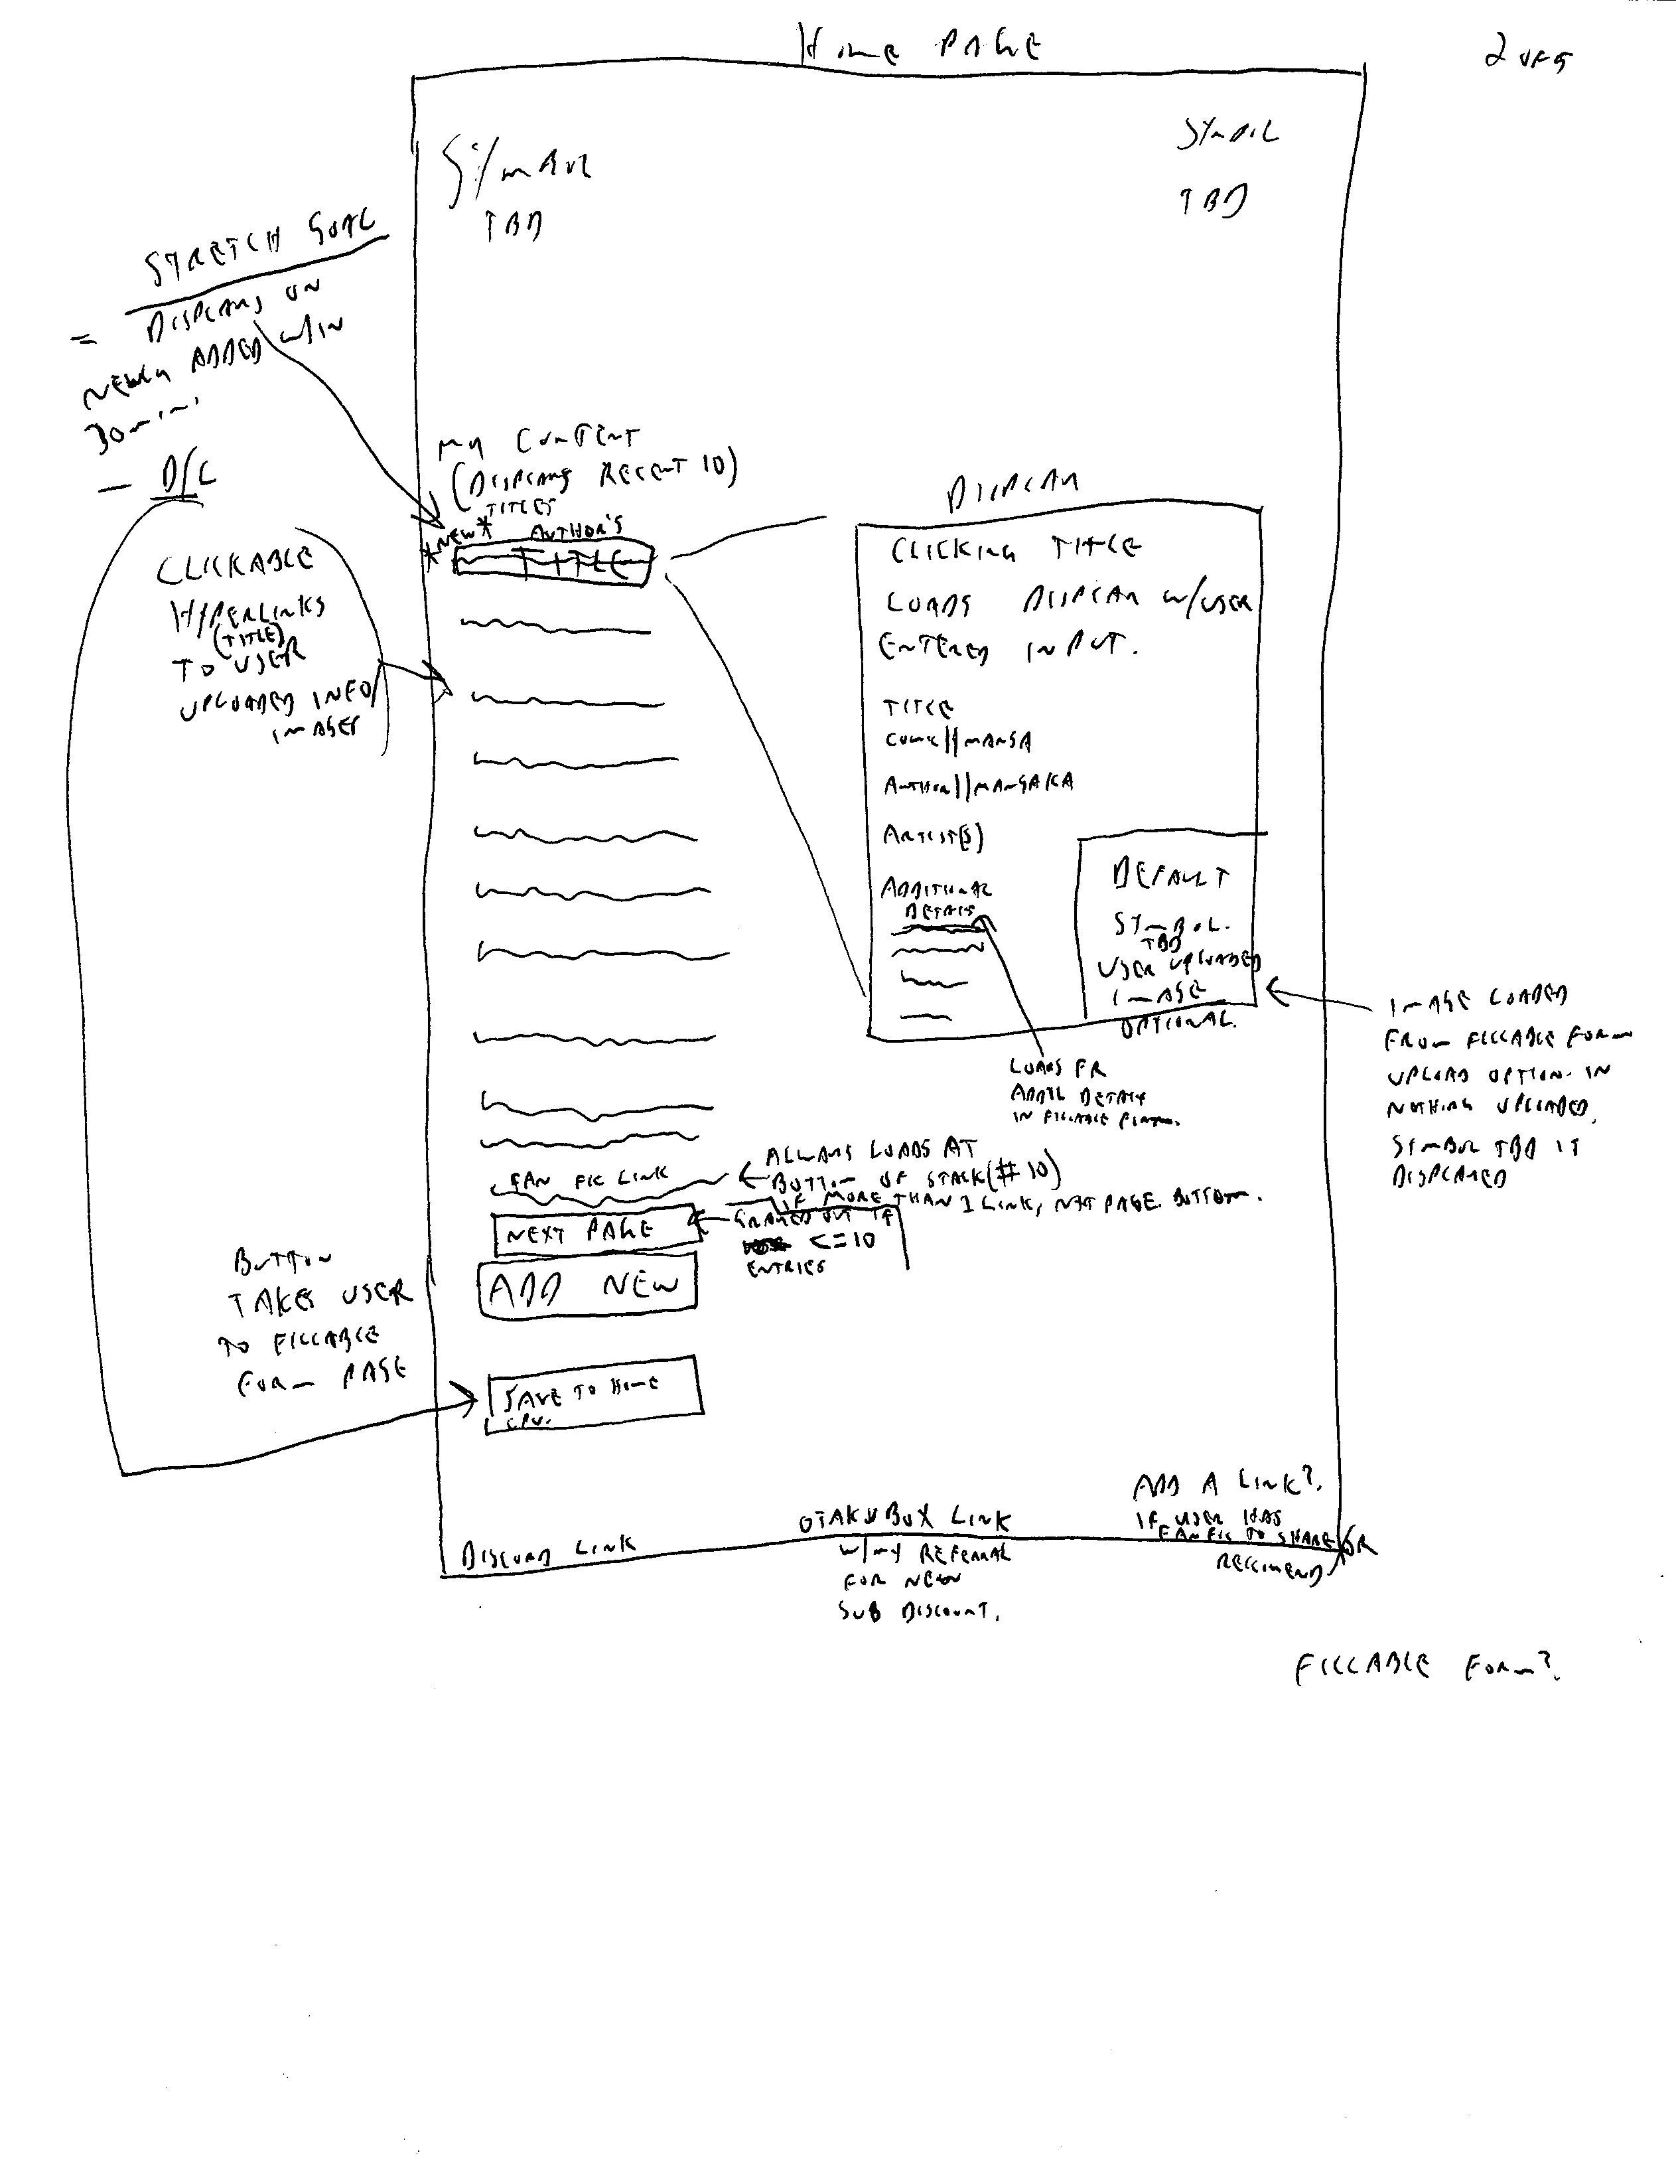
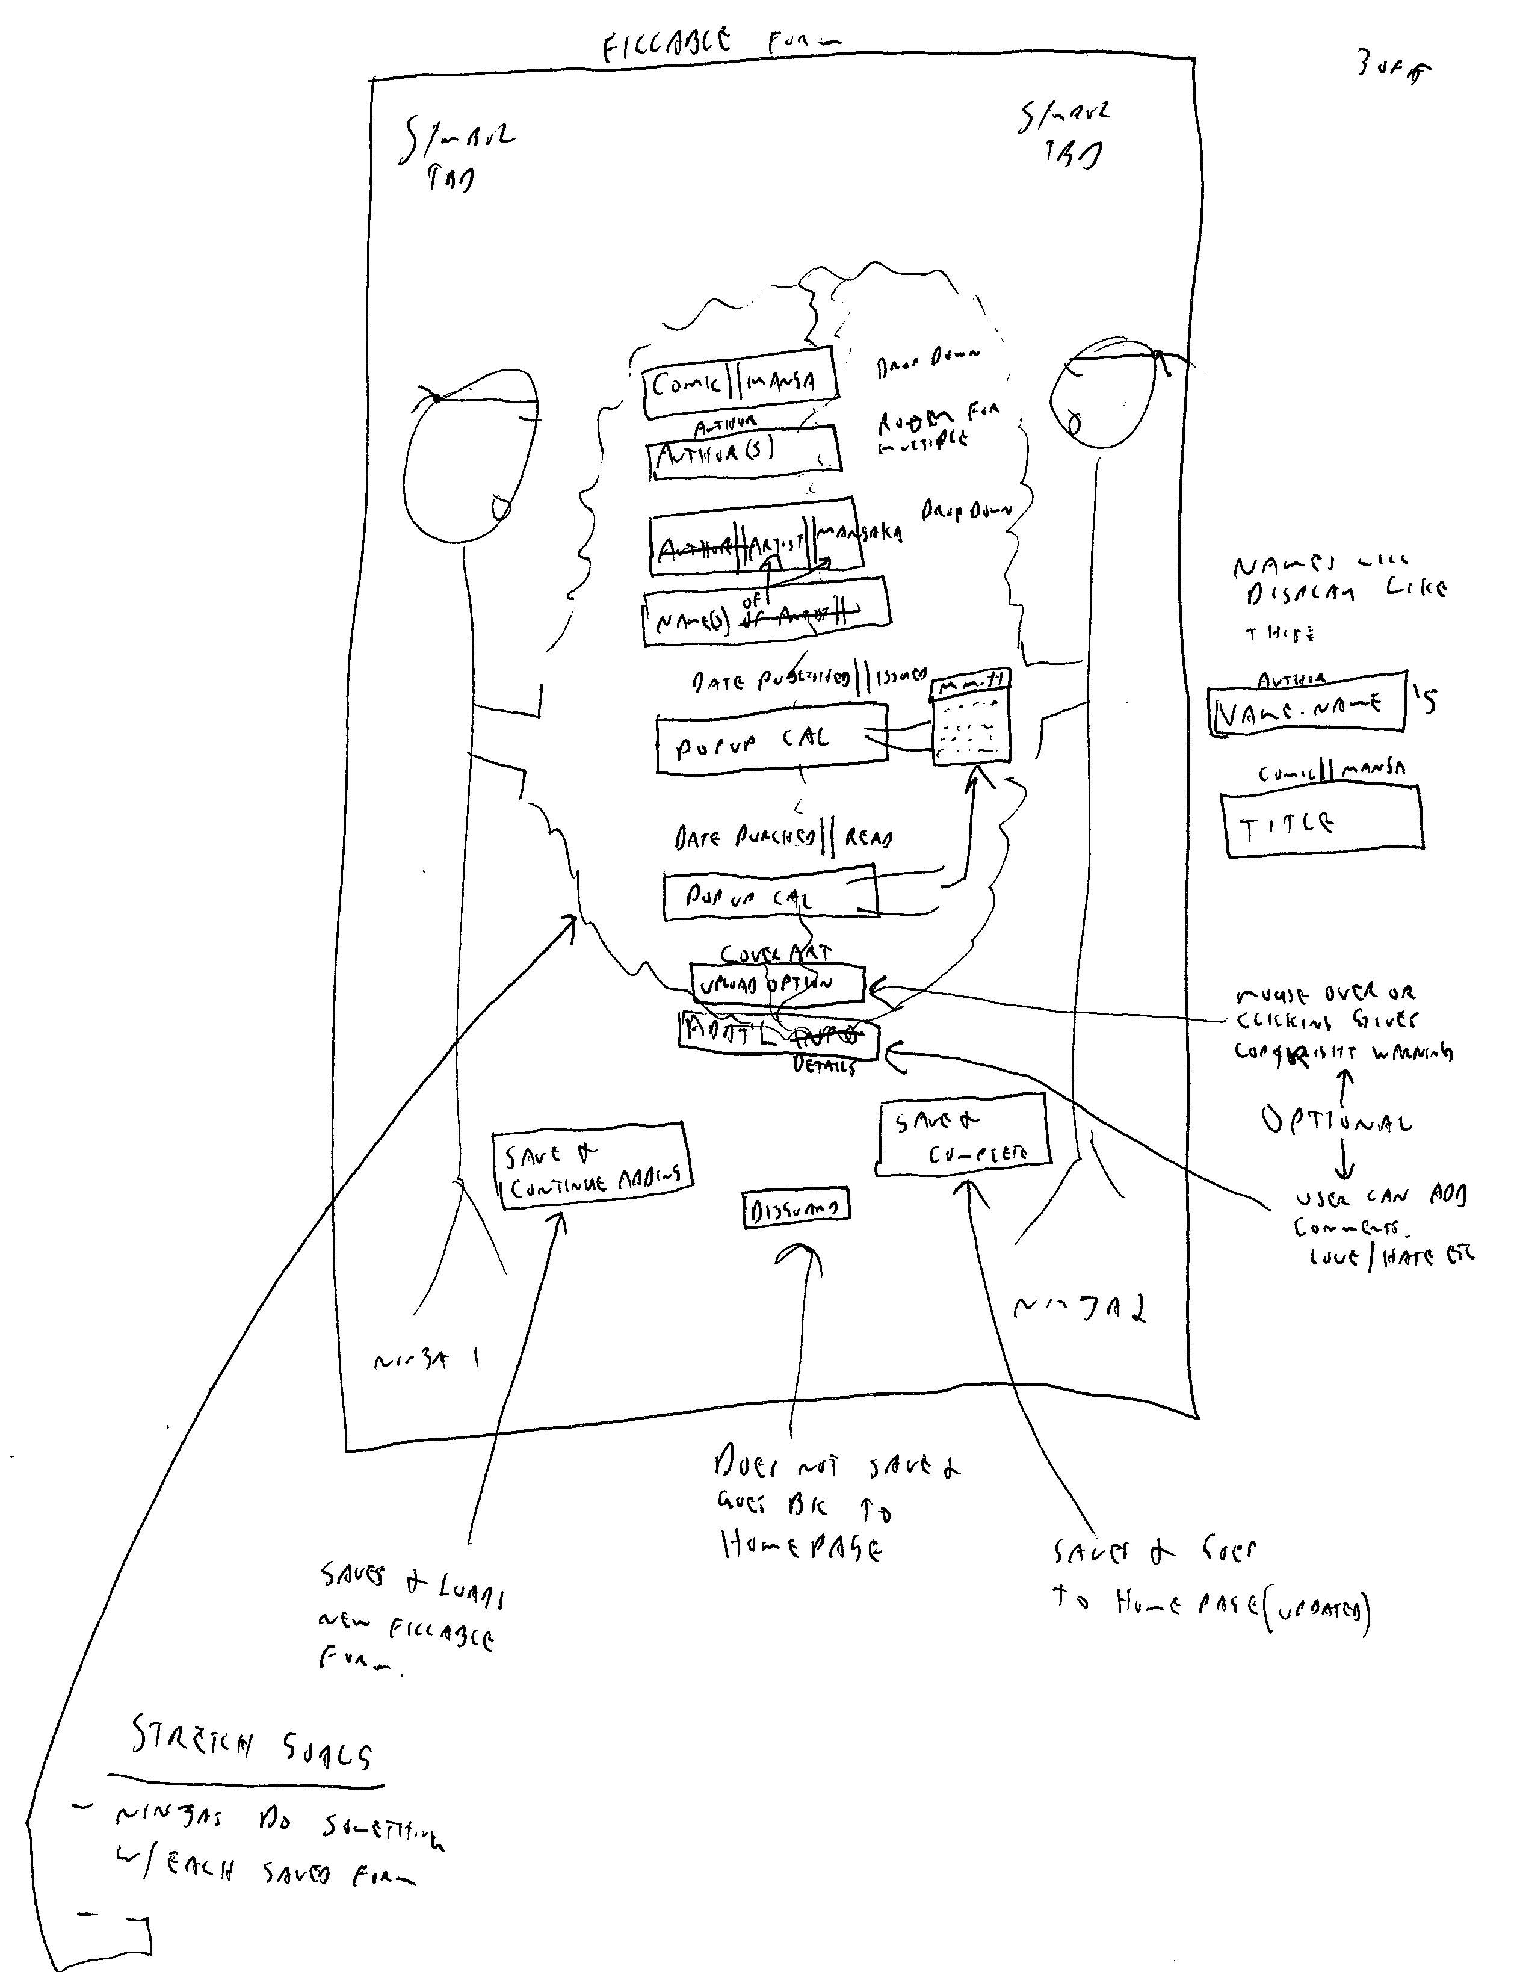
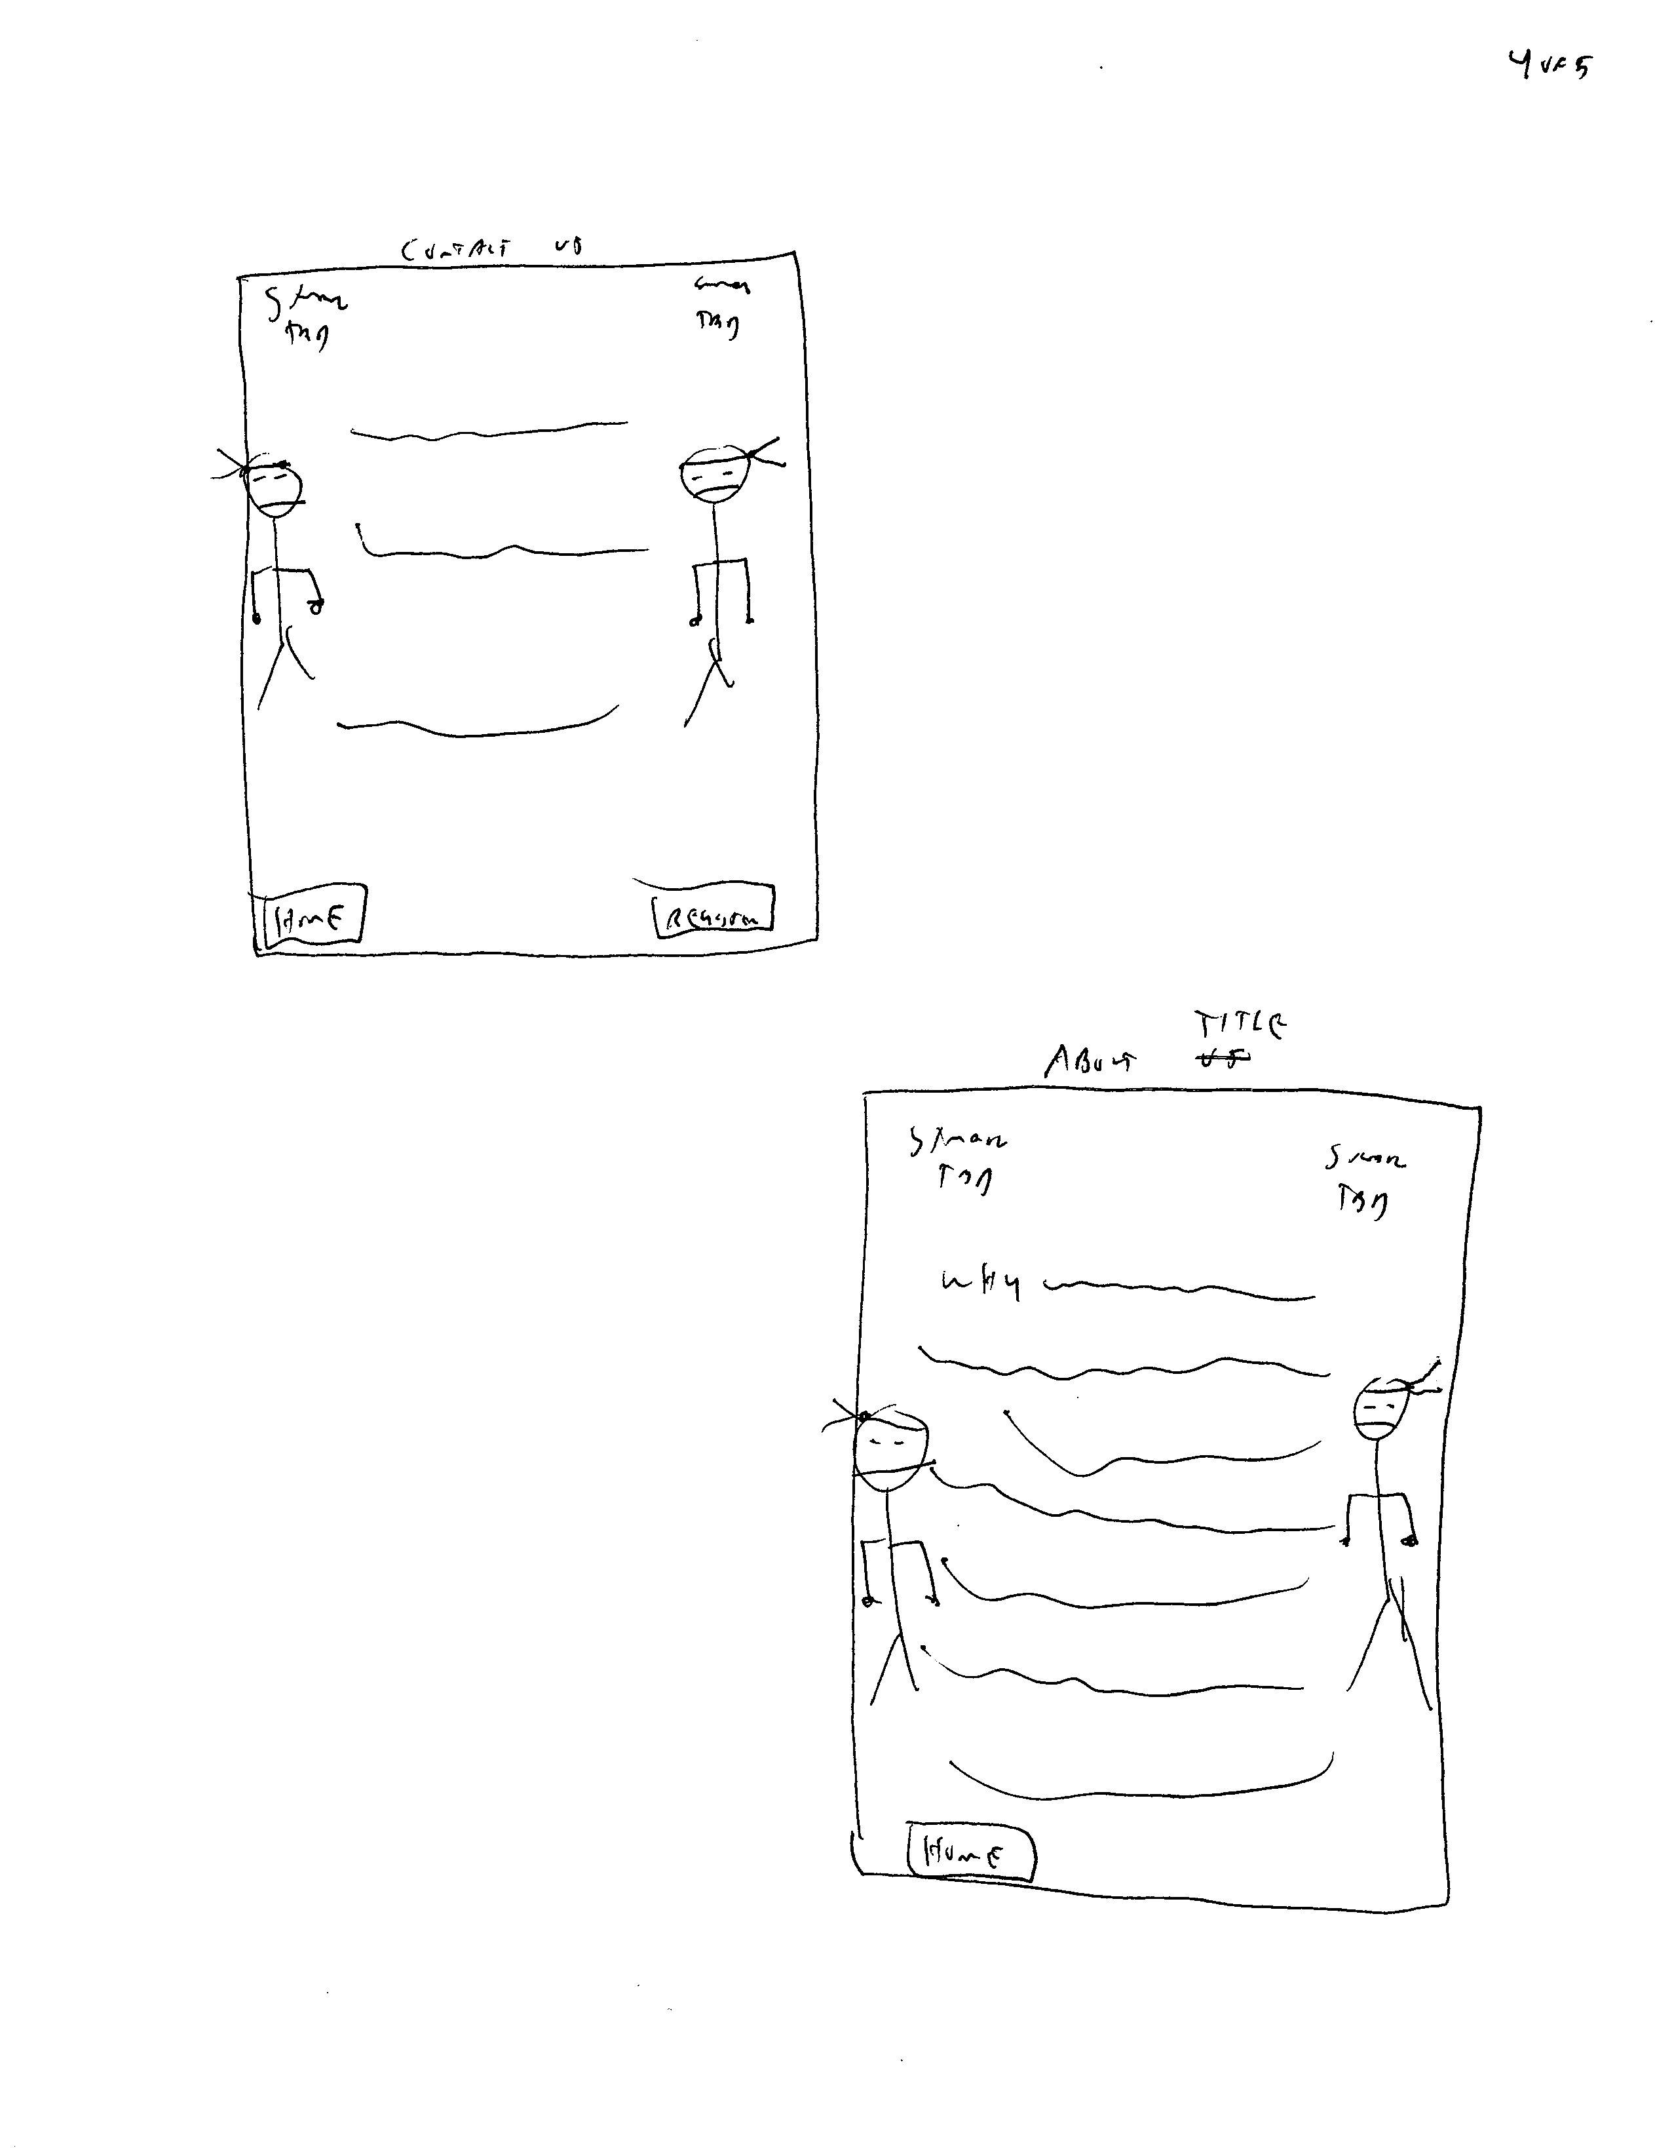
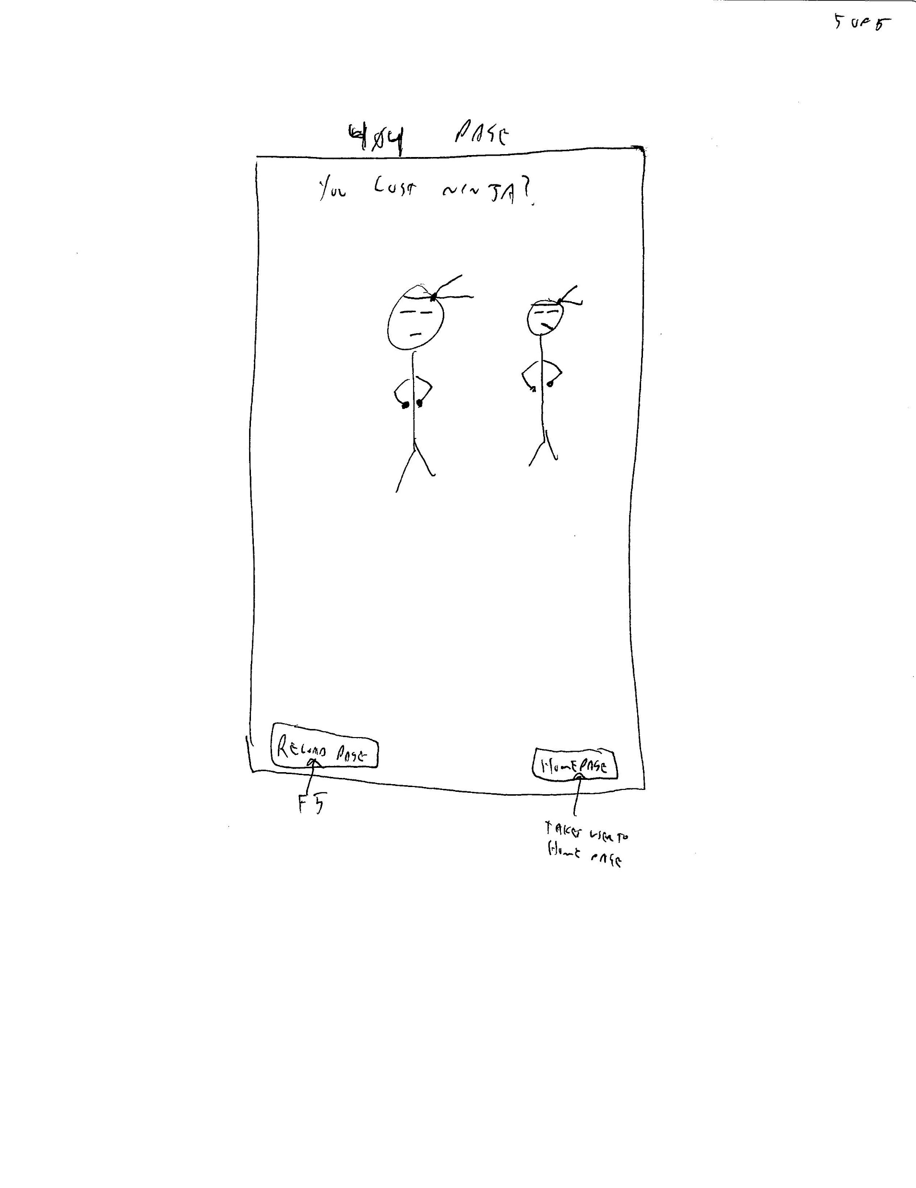
The Wire Frame Workshop

Slide 8
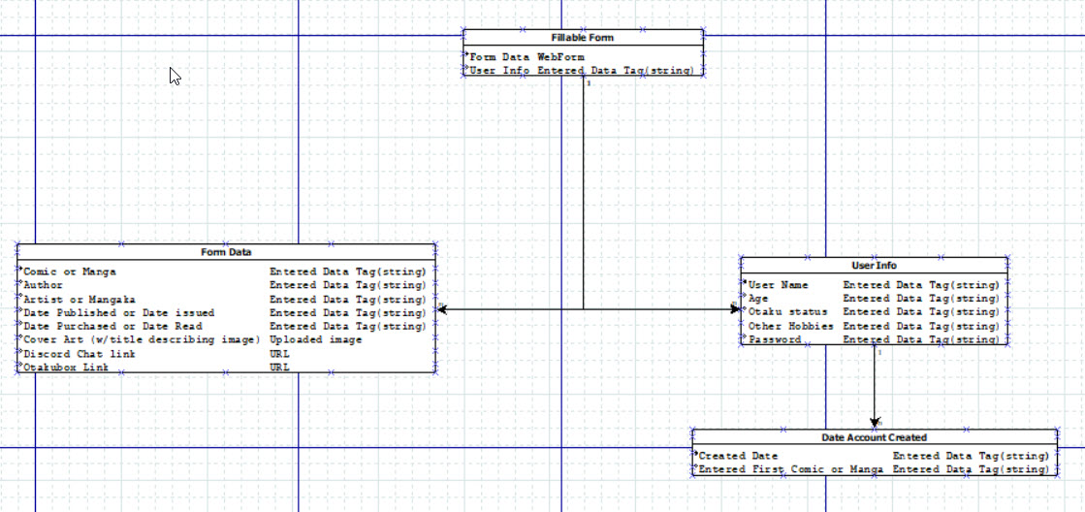
ER Diagram

Slide 9
Final
<Web-link goes here>

